Slide 1
Leveraging LLMs to Explore Clinical Study Meta Data on Skin Care Treatments
Stu Synakowski | Matt Wall | Matt Klich

Slide 2
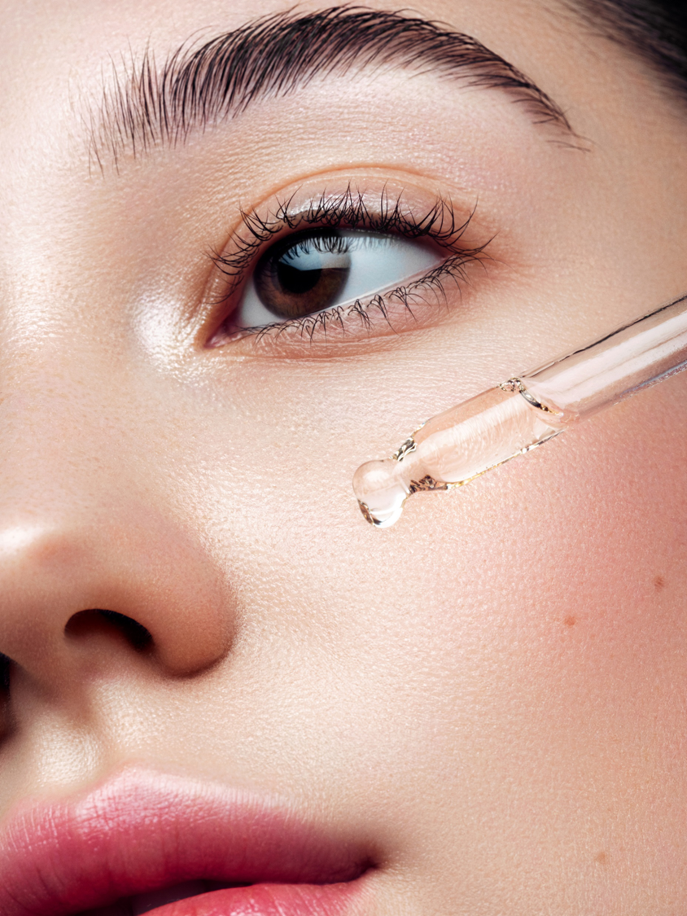
Skin Care R&D at P&G
Baby Care
OLAY
Fabric Care
Family Care
Feminine Care
Grooming
-
Hair Care
SK II
Home Care
Multi-brand Programs
Oral Care
Personal Health Care
NATIVE
Skin & Personal Care

Slide 3
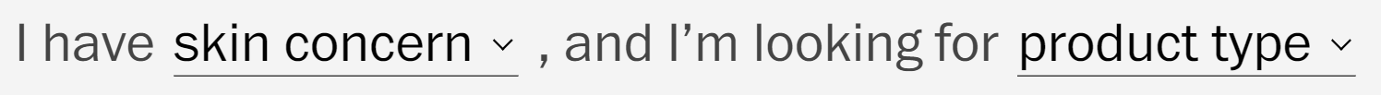
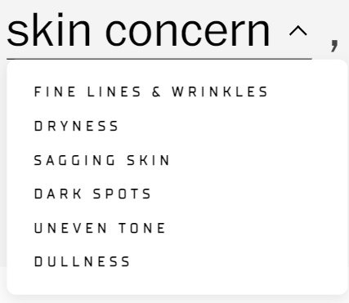
Skin Care R&D at P&G
Identifying skin conditions as unmet consumer needs
Q1: What are the known skin concerns of our consumers?
Q2: Are there skin concerns that we are not yet addressing?
Q3: How do skin concerns break down by demographics?

Slide 4
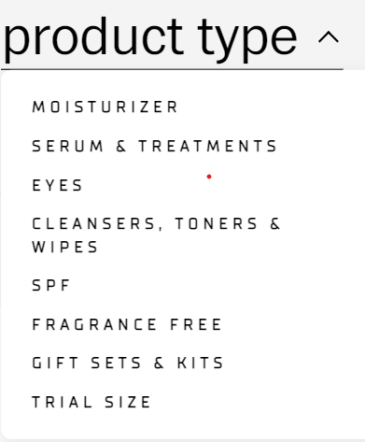
Skin Care R&D at P&G
Optimizing products to satisfy consumer skin concerns
Q4: Which products are best matched for the given skin concern?
Q5: Could existing products be modified to better serve a niche market?
Q6: Which new products are necessary for consumers with unmet needs?

Slide 5
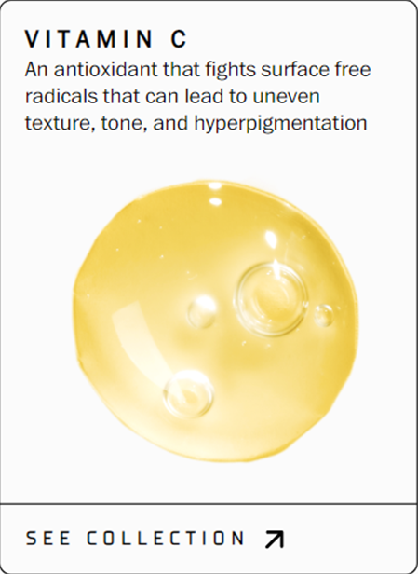
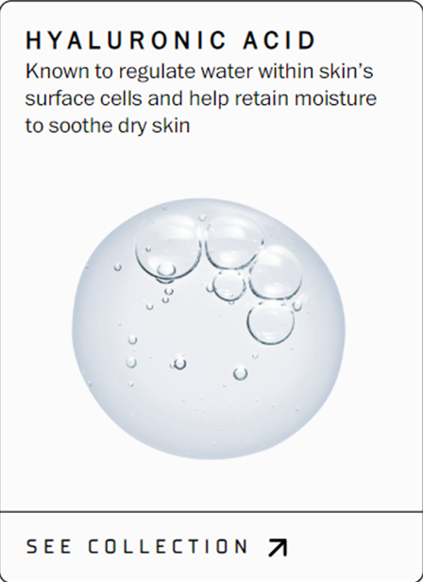
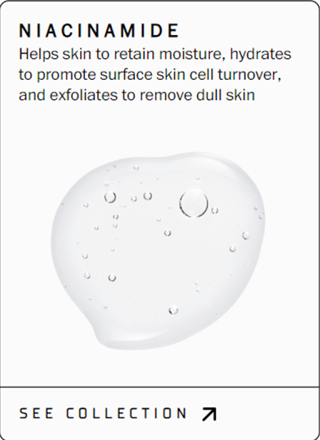
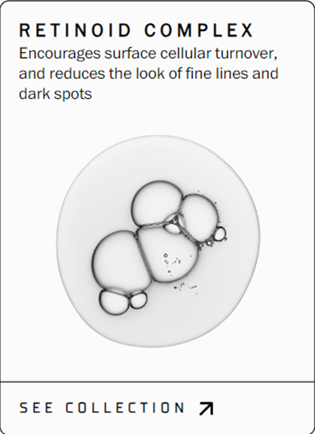
Skin Care R&D at P&G
Discovering effective ingredients for new formulations
Q7: Which ingredients are best matched to the skin concern?
Q8: Are there new ingredients that we should consider?

Slide 6
Skin Care R&D at P&G
Essential questions to consider
What are the skin concerns of our consumers?
How do skin concerns break down by demographics (e.g., age, ethnicity, etc.)?
Which unmet needs in skin care should we explore?
How can we best match our products to consumers with specific concerns?
Which ingredients should we consider to create a superior product?

Slide 7
Background for this Challenge
We are interested in exploring the vast landscape of skin care research conducted by other researchers.
Reviewing the extensive clinical research available can be laborious and costly for humans.
Goal: harness the power of LLMs to explore and understand this clinical research more efficiently.

Slide 8
The Challenge
Structuring Meta Data on Skin Care Clinical Trials to Tell a Story and Answer Key Business Questions
Leverage LLMs in telling compelling stories.
Analyzing collected metadata and presenting insights about the skin care research landscape.
Highlight what has been done in the field, summarize the key findings, and identify actionable insights that can drive further advancements in skincare treatments.

Slide 9
Format of the Challenge
The hackathon challenge will be organized into three stages (or checkpoints).
Two earlier stages early on Friday afternoon, And one final stage (biggest portion of the project) throughout Friday evening and Saturday morning.
While the earlier stages will be used more for you all to become acquainted with the framework. The latter stages will be more challenging will be more open-ended. Before each stage you will be given a prompt (a word document) on the challenge.

Slide 10
Self-Assessment
After each checkpoint (or stages) we will self-critique to improve our approaches and insights.
We will try to coach you all in assessing the correctness of your claims, substantiating your claims with evidence, and improving your overall approaches.

Slide 11
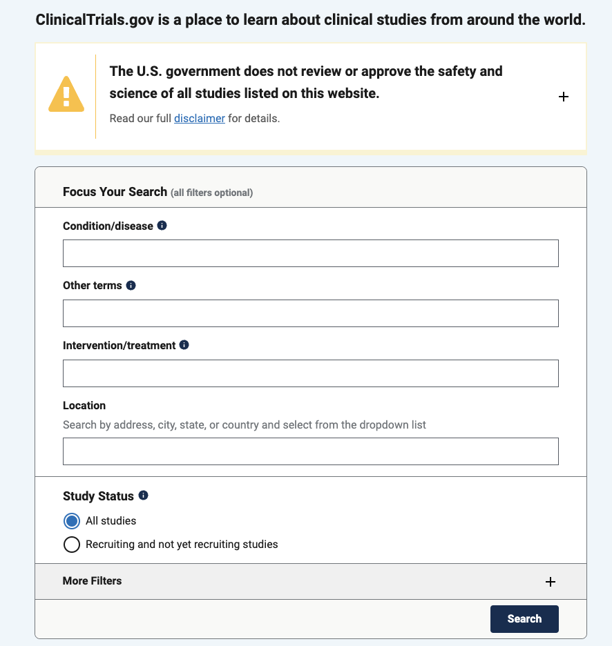

The Data
?

Slide 12
Methods
We have set up some environments with UC to leverage python and LLMs to help perform this analysis.
We encourage you to use your personal (local resources) or the resources provided.
All other tools at your disposal are permitted.

Slide 13
Skills Gained
Learn how to write effective prompts for LLMs to answer questions of interest
Learn how to structure LLMs efficiently when there are token and or hardware memory limits
Learn how to fuse LLMs with conventional data-science methods in python
Learn how to become proficient data scientists telling substantiated stories and make actionable claims

